Slide 1
IBM DATA SCIENCE SPECIALIZATION CAPSTONE
Car accident severity prediction
Barche Blaise Forgwa

Slide 2
INTRODUCTION
The outcomes of road traffic accidents are often influenced by the reaction time of traffic surveillance systems to contact emergency health care workers in case of human injuries or construction teams in case of property damage.
This project sought to build a prediction model for severity of road traffic accidents ( human injuries or property damage) such that traffic surveillance systems may prioritize the teams (health care teams or construction teams) to deploy to an accident site in future
Accidents.

Slide 3
Data understanding
The Seattle Car Accident Database was obtained from (Seattle car collision data)
This data set contained (194673 rows and 38 attributes)
The accident severity was a categorical variable ranging from (property damage to human injuries)
Logistic regression model was used to build a classification model to predict car accident severity

Slide 4
Data understanding
Selected features after data cleaning the target variable was SEVERITYCODE(recoded as 0 =property damage and 1=Injury)
Feature | Description
INATTENTIONIND | Whether or not collision was due to inattention (Y/N)
UNDERINFL | Whether or not a driver involved was under the influence of drugs or alcohol
WEATHER | A description of the weather conditions duringthe time of the collision.
ROADCOND | he condition of the road during the collision(Dry, wet)
LIGHTCOND | The light conditions during the collision
SPEEDING | Whether or not speeding was a factor in thecollision. (Y/N)
ADDRTYPE | Collision address type: ( Alley, Block ,Intersection)

Slide 5
METHODOLOGY
Following data visualization and cleaning , the data was balanced with SMOTE function from the imblearn library. The
Three classification models from the scikit learn library were used to build prediction models including:
Logistic regression
K-nearest neighbors
Decision tree classifiers
Folium was used for geospatial plotting of different accident incidents

Slide 6
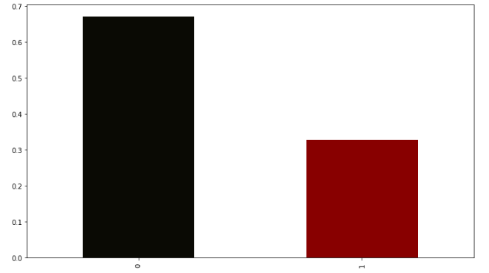
Percentage of accident severity
Property damage
Injury

Slide 7
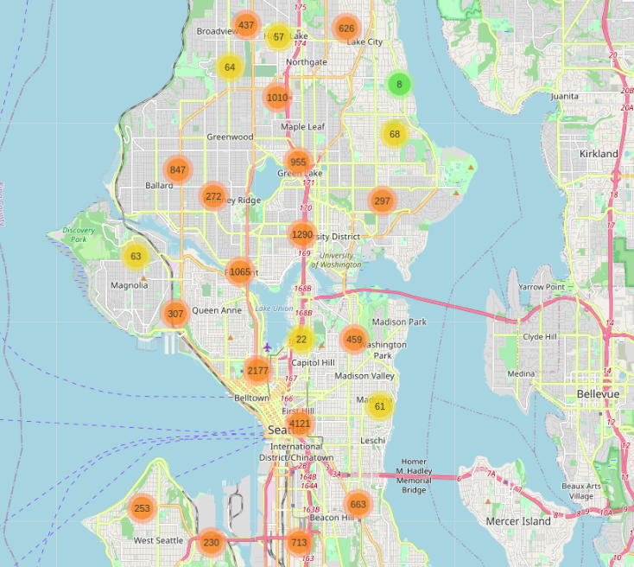
Car accidents were more common along major roads in the city

Slide 8
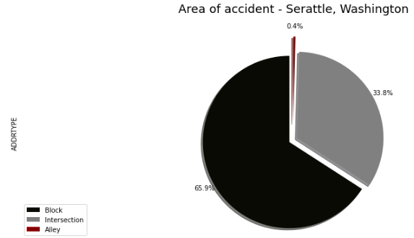
Car accidents were more common were there was a block or an intersection

Slide 9
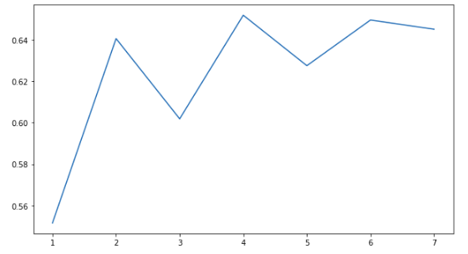
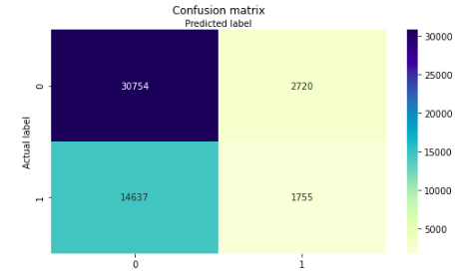
Results
KNN neighbor model
k=4
F1 score : 0.58
Accuracy score: 0.65
Precision: 0.39
Recall: 0.10
Best K for KNN model

Slide 10
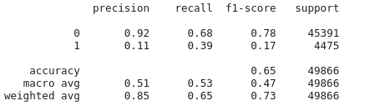
Results
KNN neighbor model
The KNN classifier predicted a property damage(0) better than it did an injury(1)

Slide 11
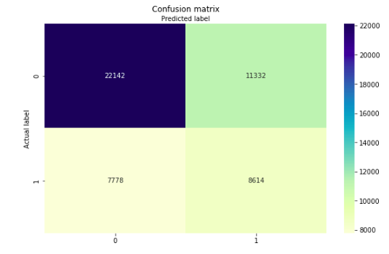
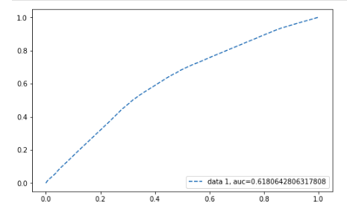
Logistic regression model
AUC: 0.62
Precision: 0.43
Recall: 0.52
F1 score : 0.62
Accuracy score: 0.62

Slide 12
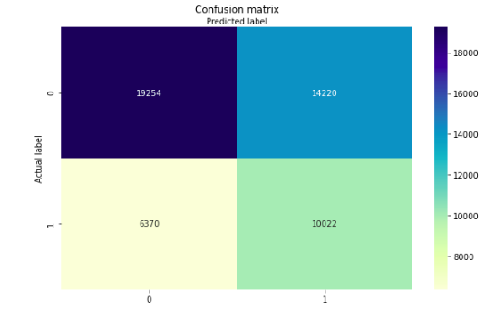
Decision tree model
F1 score : 0.60
Accuracy score: 0.58
Precision: 0.41
Recall: 0.61

Slide 13
Comparing evaluation of the models
Model | F1 score | Accuracy | recall | precision
KNN | 0.58 | 0.65 | 10 | 39
Logistic regression | 0.62 | 0.62 | 43 | 52
Decision tree | 0.60 | 0.58 | 0.61 | 0.41
Logistic regression model predicts relevant results better than the other classification models

Slide 14
Discussion
The precision simply means the percentage of relevant predictions by the model, whereas the recall implies the percentage of relevant predictions correctly predicted by the model. Though there is often a tradeoff between these two evaluation matrices, the F1 score obtains the harmonic mean between these two evaluators.
Overall, the three models had an accuracy between 58 to 65 %
The decision tree model had a better precision that the other two models
The AUC(area under the receiver operator characteristic curve) measures the capability of distinguishing classes and ranges from 0(no ability to distinguish classes) to 1(can perfectly distinguish between classes)

Slide 15
Conclusion
The three models were modest in predicting car accident severity.
This could be improved by:
Obtaining more data regarding speeding condition of drivers
Better classification of road, light and weather conditions
Nevertheless the logistic regression model proved to be a better classifier model than the others

Slide 16
Recommendations
To drivers
Be cautious in major roads in the city
Be cautious when driving along a block or when approaching an intersection
To traffic surveillance system:
Obtain more information from drivers to enable creation of robust models

Slide 17
References
Precision and recall
understanding ROC and AUC
Seattle geodata

